Slide 1
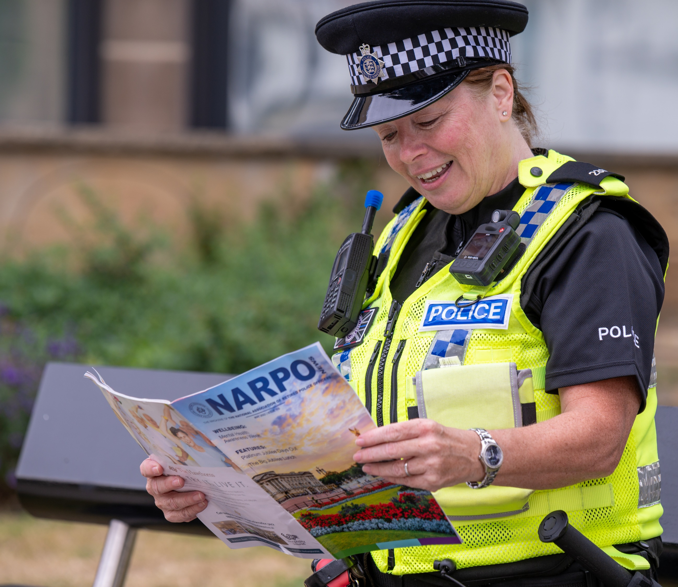

NARPO
The Voice of Retired Police Officers
Pre-Retirement
Presentation
Visit: www.narpo.org
Call: 01924362166
Email: hq@narpo.org

Slide 2
WHO ARE NARPO?
NARPO is a UK-based, rank-free association of retired police officers dedicated to improving benefits for all members.
We have 105 branches with over 93,000 members throughout England and Wales, making us one of the largest public sector pensioner organisations in the country.
Our approach is threefold, in providing advice and support in Life, Work and Leisure after the Police.
Visit: www.narpo.org
Call: 01924362166
Email: hq@narpo.org

Slide 3
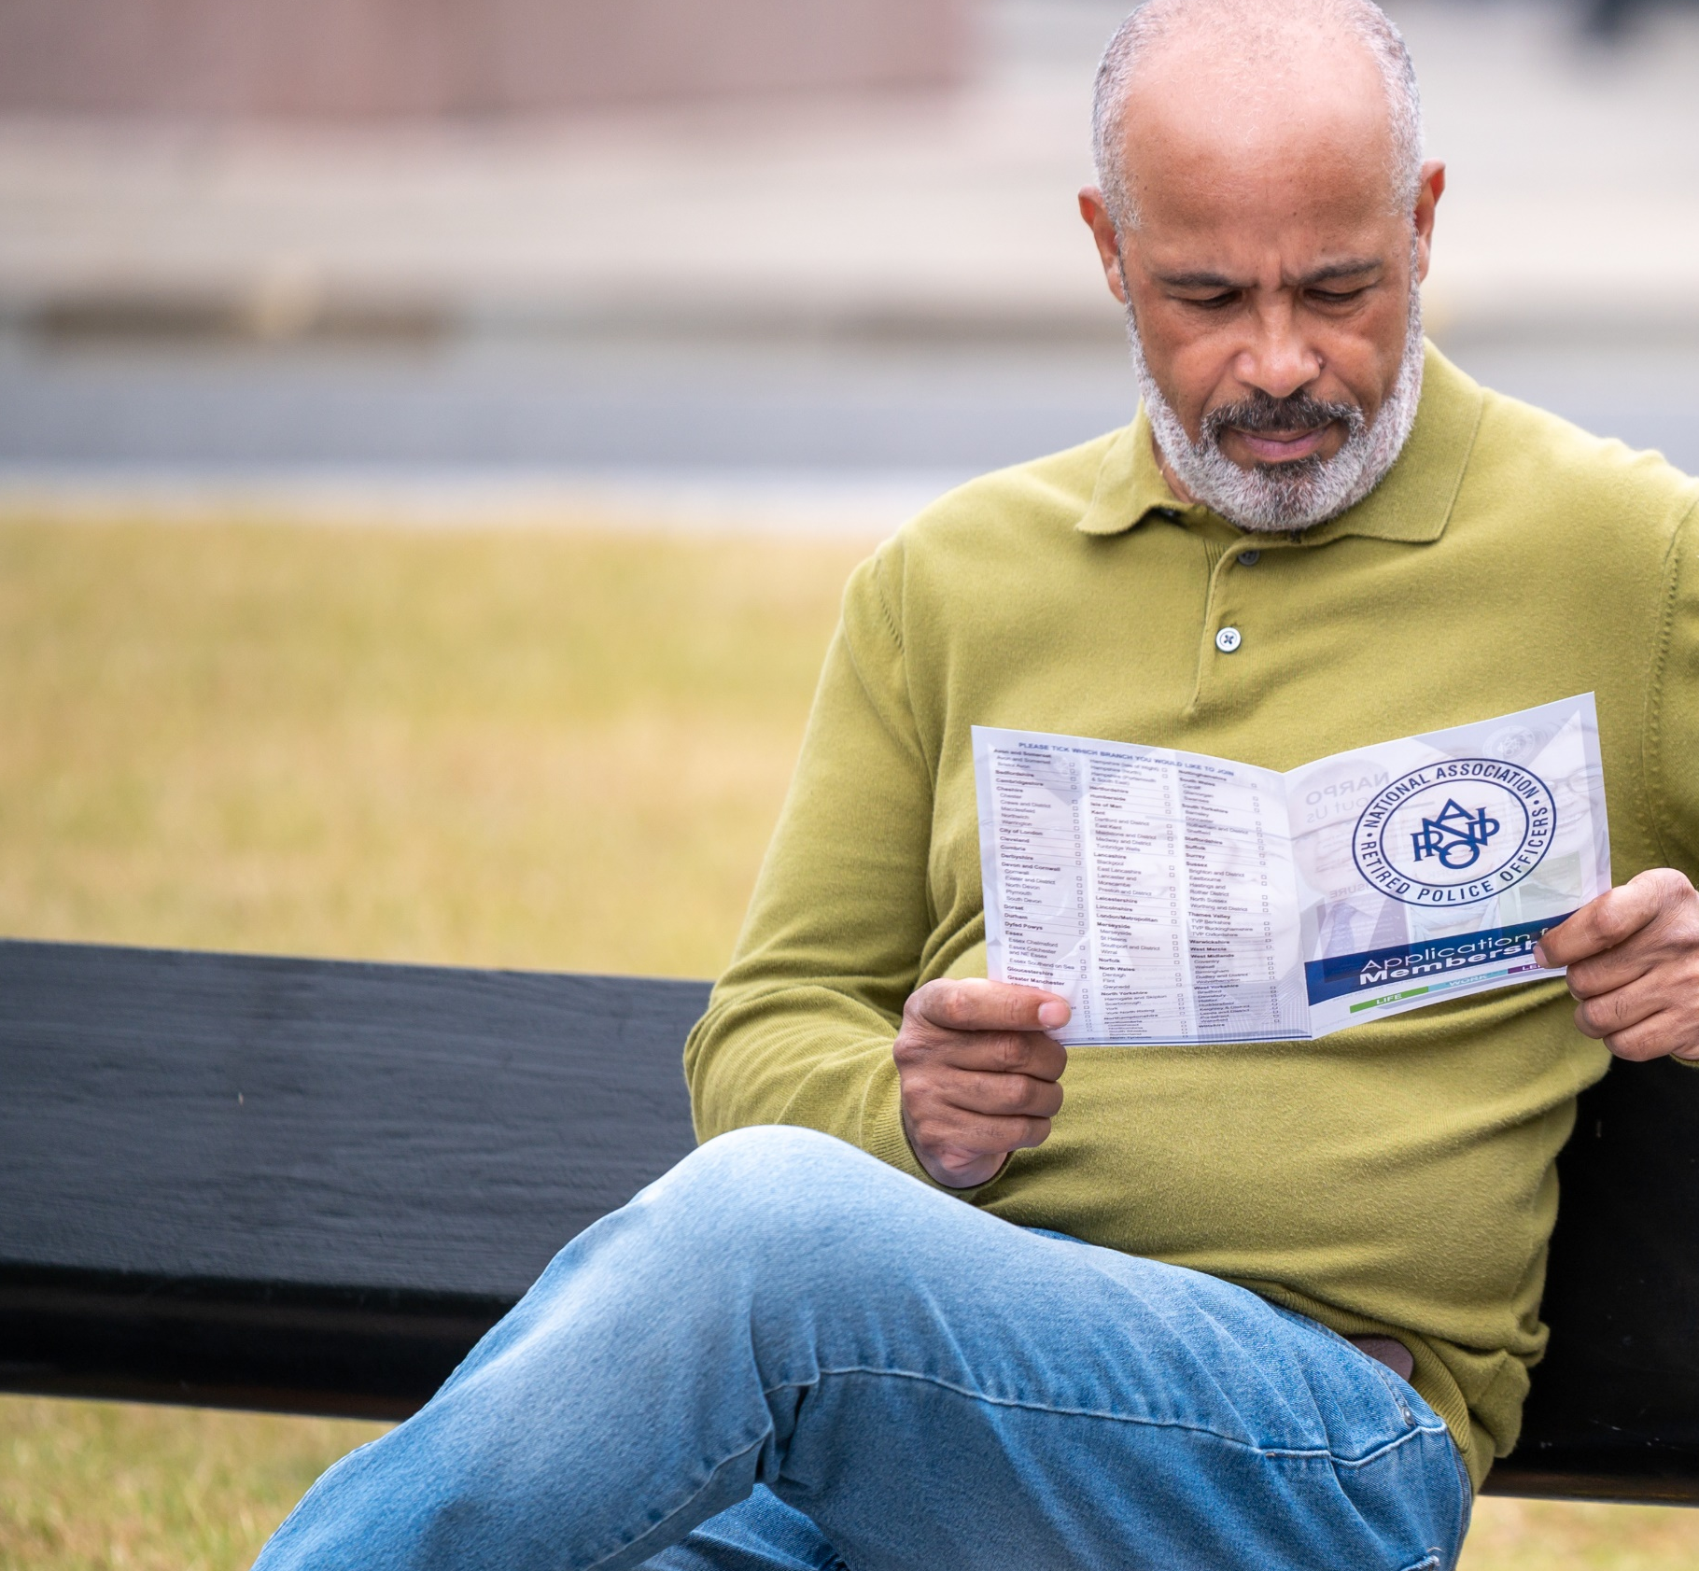
Our Members
Full Members
Full Membership is open to former Police officers who have served in a Police Force and who have met the minimum requirements that would entitle them to a police pension.
Members
Granted by a Branch Committee to any person who is not eligible to join the Branch as a Full Member, which includes widows, widowers, partners and spouses.
Visit: www.narpo.org
Call: 01924362166
Email: hq@narpo.org

Slide 4
Member Benefits
Exclusive discounts on holidays and breaks
Offers on high street brands through Perkjam
Discounts on products Inc. Whirlpool and new cars
Digital Job Board with Roles that are suited to ex-officers
Access to NARPO’s travel and healthcare insurance
Member rates on car and home insurance from Police Mutual
Visit: www.narpo.org
Call: 01924362166
Email: hq@narpo.org

Slide 5
Member Services
Pensions and Benefits
NARPO provide advice and assistance on a wide variety of topics including police pensions. There are also free advice services for Members on state benefits, IT and taxation.
Wellbeing
NARPO work with a range of organisations to provide members with a variety of wellbeing resources. Your local Branch may also have a team of Welfare Representatives who can provide signposting.
Contact and Support
The NARPO website has an exclusive members section allowing access to the latest information and offers. NARPO HQ is able to take enquires by phone and email, Monday-Friday.
Visit: www.narpo.org
Call: 01924362166
Email: hq@narpo.org

Slide 6
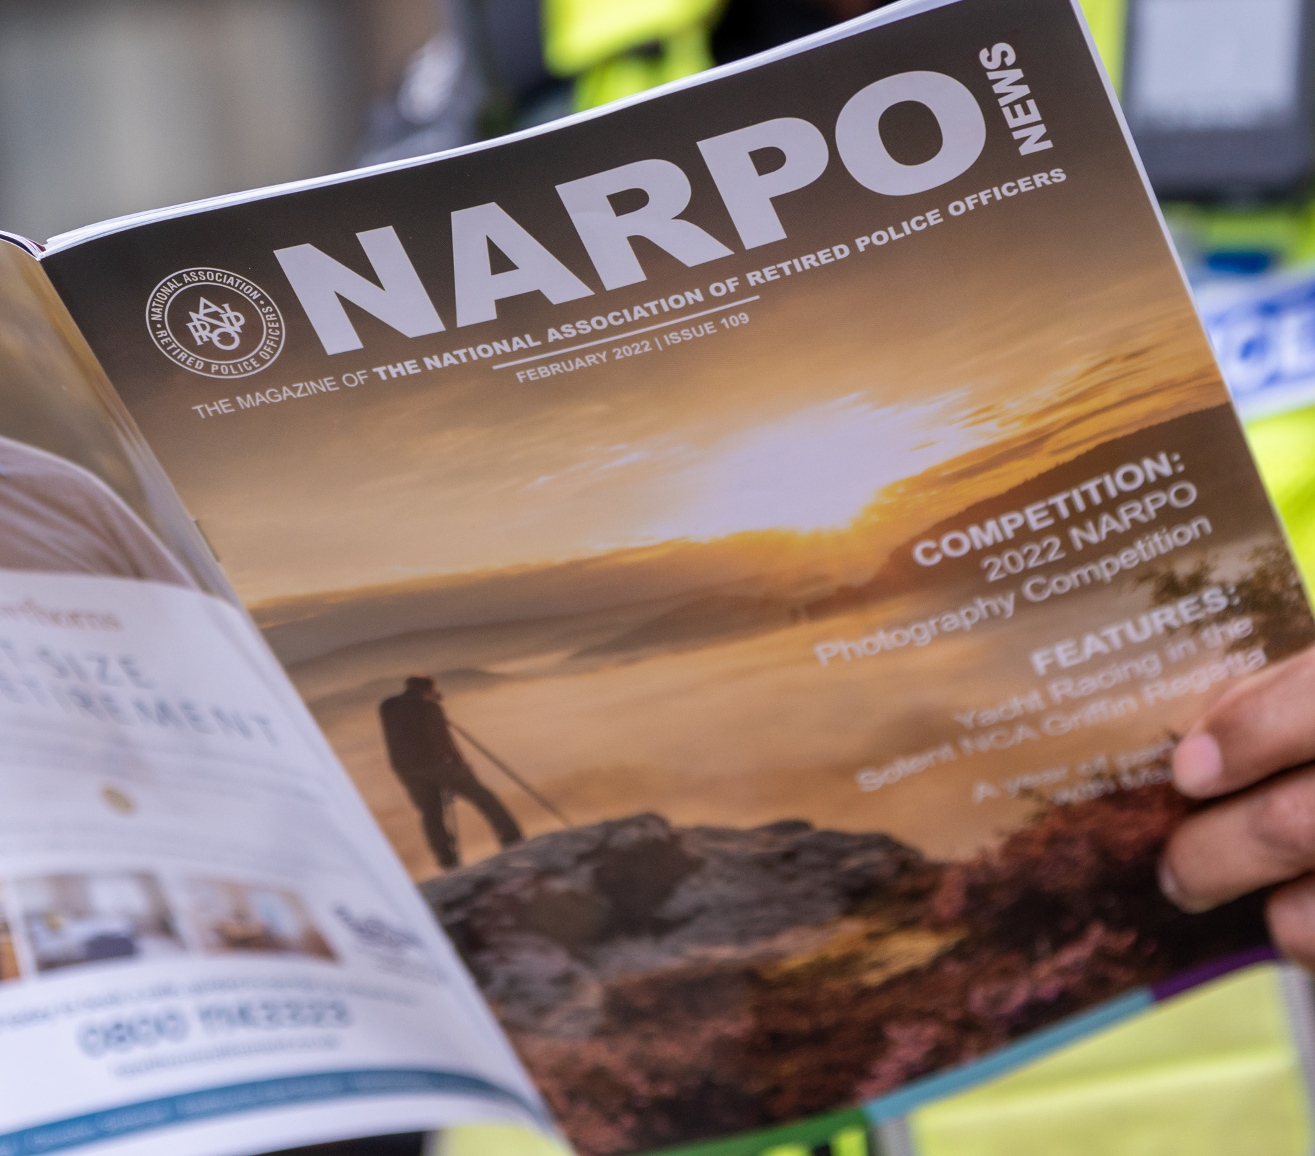
Staying Connected
NARPO News
NARPO News is NARPO’s quarterly membership magazine posted directly to all members.
The magazine is well-received by our members, with each issue offering the latest news, pension benefits updates and advice on a range of issues such as wellbeing and computer know-how.
New Horizons
NARPO also have a digital Newsletter, New Horizons, designed to keep members updated with the latest offers, campaign work and pensions advice.
Visit: www.narpo.org
Call: 01924362166
Email: hq@narpo.org
Visit: www.narpo.org
Call: 01924362166
Email: hq@narpo.org

Slide 7
Campaigning
Public Service Pensioners Council
We’re an active member of the Public Service Pensioners Council. PSPC brings together the various organisations for retired public servants and the retired members’ sections of public sector unions, providing a united voice on issues of concern to government and the public.
LLA
We are part of the campaigning group Later Life Ambitions - encouraging the Government to adopt policies that support older people.
AGE UK
We are also a member of AGE UK and Wales Seniors Forum
Visit: www.narpo.org
Call: 01924362166
Email: hq@narpo.org

Slide 8
Your Local Branch
Branch Information goes here.
Visit: www.narpo.org
Call: 01924362166
Email: hq@narpo.org

Slide 9
Joining NARPO
By joining NARPO, you’ll be supporting an organisation actively campaigning on behalf of former Police Officers and their families. Not only will you be contributing towards a movement which, together with its Partner bodies, represents the views of over 1 million older people in the UK, but you’ll also be eligible for some fantastic benefits.
The subscription rate for 2023 is only £24.60 for the whole calendar year.
Visit: www.narpo.org
Call: 01924362166
Email: hq@narpo.org

Slide 10
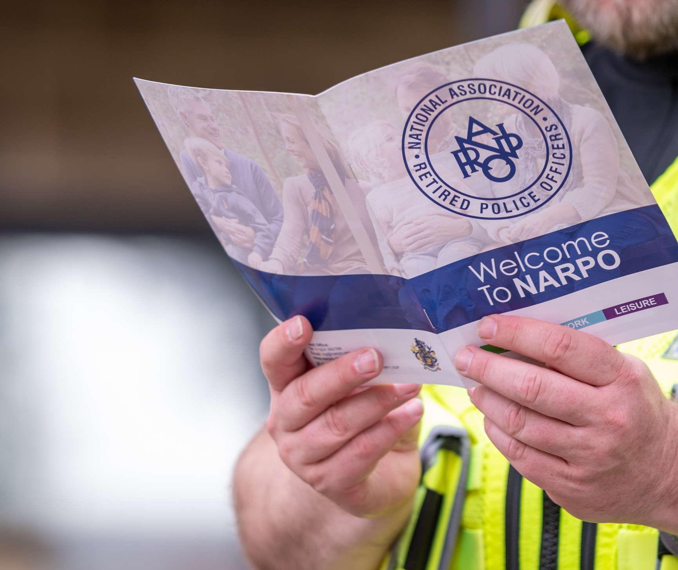
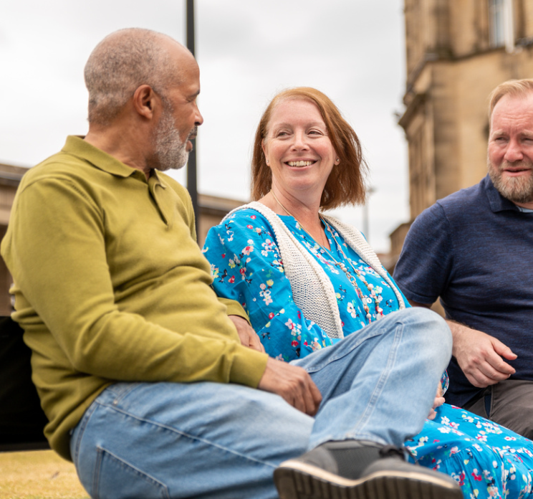

To find out more visit: www.narpo.org
01924 362166 hq@narpo.org

